Slide 1
Molecular Simulations and Supercomputing/Parallel Computing
Fundamentals of Molecular Simulations
Week 3 – 1/25/19
Luke Gibson

Slide 2
Outline
Overview of MD algorithm
Which parts can be done in parallel?
Which parts must be done serially?
What are CPUs/GPUs
Introduction to parallelization schemes
OpenMP – Multithreading
MPI – Message Passing Interface
How does this help us run MD?
Examples
Running MD in multiple parallel schemes
Tips on analyzing multiple files with bash

Slide 3
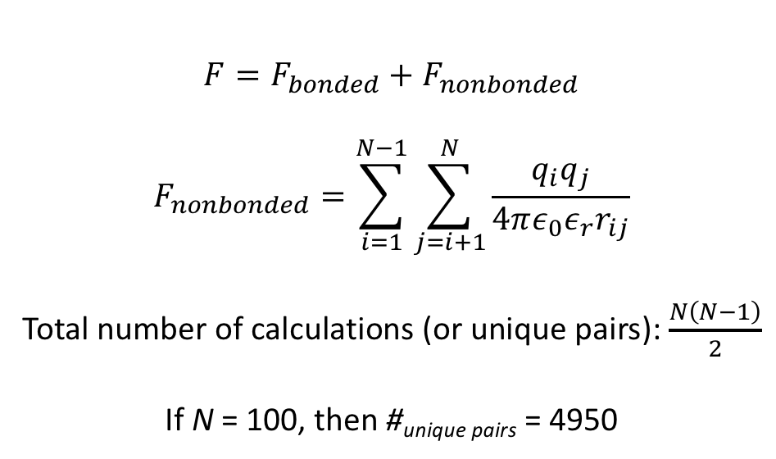
Molecular Dynamics Algorithm
$$F=F_{bonded}+F_{nonbonded}$$
$$F_{nonbonded}=\sum_{i=1}^{N−1}{\sum_{j=i+1}^{N}{\frac{q_{i}q_{j}}{4πε_{0}ε_{r}r_{ij}}}}$$
Total number of calculations (or unique pairs): $\frac{N\left(N−1\right)}{2}$
If N = 100, then #_{unique pairs} = 4950
There can be many calculations for even a small, simple, classical MD simulation!

Slide 4
Serial vs. Parallel Calculations in MD
Calculate all atomic positions for t + △t
Calculate a single atom’s position for t + △t
Calculate all non-bonded interactions
Calculate a single atom’s non-bonded interactions
Calculate all bonded interactions
Calculate a single atom’s bonded interactions
Parallel
Serial

Slide 5
What is a CPU? a GPU?
CPU: Central Processing Unit
Consists of multiple processors
Anywhere from 2 to >32 processors on a CPU
Myth: More cores = Better CPU
Must account for single-core performance!
GPU: Graphics Processing Unit
>1000 processors on a GPU
Each core is much slower than a core on a CPU
Good for parallel tasks because # of processors

Slide 6
Hyak Supercomputer
Ikt
16 cores / node
~64 GB RAM
65 nodes on Pfaendtner
64 nodes on STF
Going away in 2☹2☹
Mox
28 – 32 cores / node
128+ GB RAM
10 nodes on Pfaendtner
92 nodes on STF
10 GPU nodes on STF

Slide 7
How do we parallelize code?
OpenMP – Multi-threading
Creates multiple threads which contain a number of calculations that can be executed independently
Shared memory
Cannot thread beyond a single node (or computer)
MPI – Message Passing Interface
User defines number of MPI ranks, where each MPI rank is essentially a copy of the program that executes its portion of the code (e.g., summing a subset of the total data)
Allows for multiple nodes to communicate
High overhead and high memory
CUDA – Compute Unified Device Architecture
nVidia’s platform for parallelization across nVidia GPUs
Only useful for >1000 threads

Slide 8
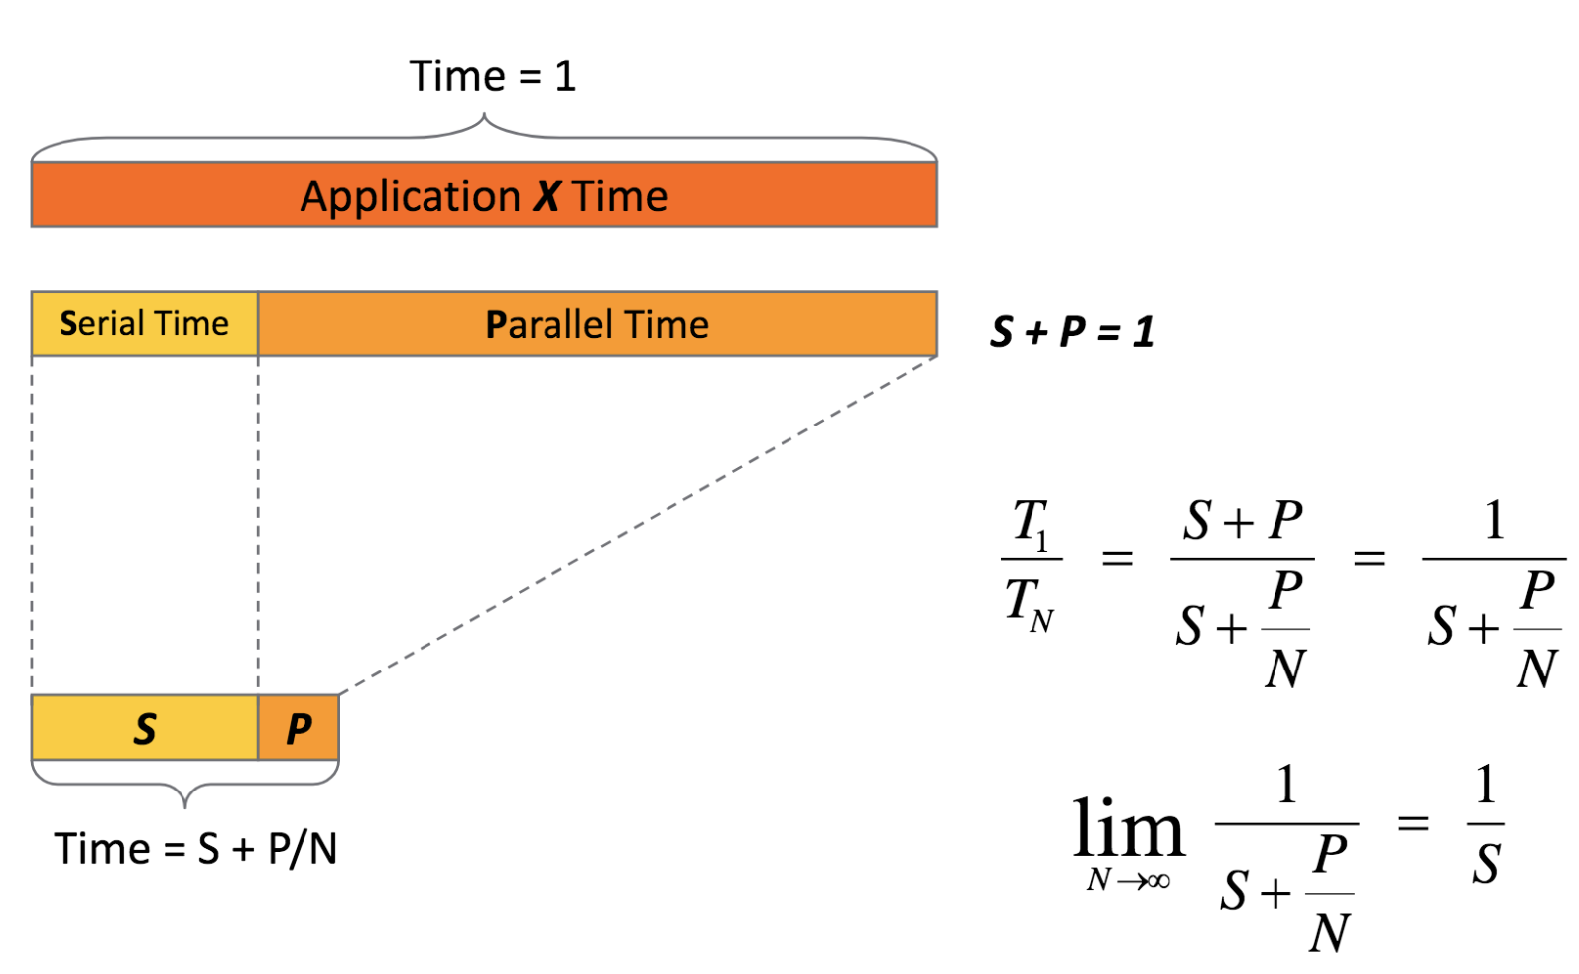
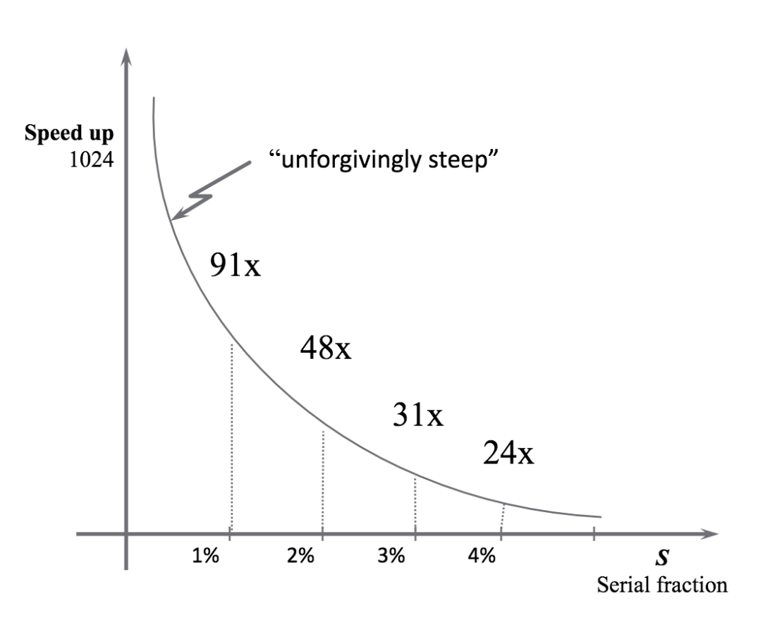
Amdahl’s Law
Parallelizing Python: Transitioning Beyond One Core. Research Computing Club.
https://github.com/UW-HPC/Parallelizing-Python-Workshop/blob/master/lectures/ParallelizationFundamentals.pdf

Slide 9
How do I make my MD simulation parallel?
mpirun -n 56 -genv OMP_NUM_THREADS 4 cp2k.psmp -i md.inp –o md.out
mpirun: Tells the computer to execute program in parallel using MPI
-n 56: Number of MPI ranks
-genv OMP_NUM_THREADS 4: Number of OpenMP threads per MPI rank
cp2k.psmp: Program that is getting executing
-i md.inp: Input file
-o md.out: Output file

Slide 10
Scaling Simulations
Computational resources are finite!
Design your large production runs to be efficient, not fast!
Unless you have a deadline coming up, like a conference in mid March and your results still aren’t complete…
Which point should you choose?
A: Best choice, most efficient
B: Maybe if you have a very hard deadline
C: Literally never, wtf?
D: Only if you own the nodes and like burning money
ns/day
A
B
C
D
Number of Cores

Slide 11
More cores
1% speed-up
my simulation

Slide 12
Basic Hyak Commands
Terminology:
Node: A single computer, which contains a CPU, RAM, and local storage (and maybe a GPU)
Login Node: Node that you connect to when connecting to Hyak. Has internet connection, but is NOT meant for any CPU intensive processes. Purely for interacting with compute nodes.
Compute Node: Node that runs CPU intensive jobs. No internet.
Allocation [-A]: Group of nodes. Typically name of node owner, e.g., pfaendtner
Partition [-p]: Subgroup of nodes within an allocation, there may only be one, in which case: partition == allocation

Slide 13
Basic Hyak Commands
Checking Node Statuses:
hyakalloc <partition>
Lists all currently running jobs and shows how many nodes are available
Does not show any jobs waiting in queue
squeue -p <partition>
Lists all currently running jobs
Shows full queue of jobs that may be waiting to run
sinfo -p <partition>
Lists node names and their statuses (e.g., idle, busy, draining, down, etc.)

Slide 14
Basic Hyak Commands
Handling Jobs:
sbatch job.slurm
Submits a slurm script that contains job settings
scancel <job_id>
Cancels job with <job_id>
srun …
Calls for an interactive node

Slide 15
Helpful Aliases
alias me=“squeue -u <netid>”
alias prg=“hyakalloc pfaendtner”
alias stf=“hyakalloc stf”
alias prgq=“squeue -p pfaendtner”
alias stfq=“squeue -p stf”
alias build=“srun -p build --time=2:00:00 --mem=10G --pty /bin/bash -l”
alias int=“srun -p pfaendtner -A pfaendtner -N 1 --time=4:00:00
--mem=120G --pty /bin/bash -l”

Slide 16
Time for the Jupyter Notebook!

